Slide 1
Real-Time Weather Intelligence
A Python-powered weather application featuring live data streams, comprehensive forecasts, interactive mapping, and AI-driven insights for intelligent decision-making.
BY: Jayanth KBY.P
Hari Yuvan
Harshith U Shetty
Jevan N

Slide 2




Project Overview
Live Weather Data
5-Day Forecast
Fetch real-time city-based conditions instantly with current temperature, humidity, and atmospheric metrics
Detailed 3-hour interval predictions providing comprehensive weather trends and pattern analysis
Visual Maps
AI Analysis
Interactive location mapping with dynamic weather icons and geographic visualization capabilities
Smart recommendations powered by Gemini AI for health, travel, and activity planning insights
Built with Python and Tkinter for a seamless, responsive desktop experience optimized for speed and usability.

Slide 3



API & Data Layer
OpenWeatherMap API
Reliable weather data service providing global coverage with real-time updates and historical data access
Requests Library
HTTP client enabling seamless API communication with robust error handling and timeout management
JSON Processing
Efficient data parsing extracting temperature, humidity, pressure, coordinates, and condition codes
The data layer ensures reliable, fast retrieval of weather information through optimized API calls and intelligent caching mechanisms.

Slide 4
Core Logic & Processing
get_weather()
Purpose: Retrieves current weather conditions for specified city with comprehensive atmospheric data
1
Returns: Temperature, humidity, pressure, condition code, wind speed, and visibility metrics
get_forecast()
2
Purpose: Fetches 5-day forecast with 3-hour intervals for accurate trend prediction
Returns: Time-series weather predictions including temperature ranges, precipitation probability, and condition changes
analyze_weather_with_ai()
3
Purpose: Processes weather data through Gemini AI model for intelligent interpretation
Returns: Personalized health recommendations, travel advisories, and activity planning suggestions

Slide 5

User Interface (GUI)
Tkinter Framework
Native desktop interface framework delivering responsive, cross-platform UI with minimal resource overhead.
Key Components:
Search input with auto-complete
Dynamic data labels and displays
Scrollable forecast tables
Interactive map widgets
Icon rendering system
Design Philosophy: Clean formatting with intuitive information hierarchy, ensuring users can access critical weather data in seconds.

Slide 6
Visualization & Insights
TkinterMapView Integration
PIL Image Processing
Gemini AI Insights
Interactive mapping widget plots geographic coordinates with dynamic weather icons, enabling visual location context and spatial awareness.
Advanced image handling engine renders weather condition icons in real-time, supporting custom graphics and smooth icon transitions.
Intelligent weather analysis generates actionable recommendations for health, activities, clothing, travel, and safety warnings based on current conditions.

Slide 7
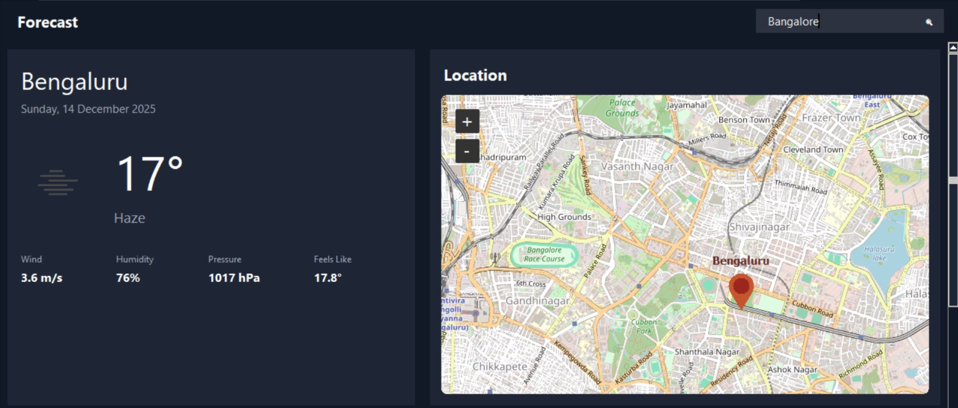
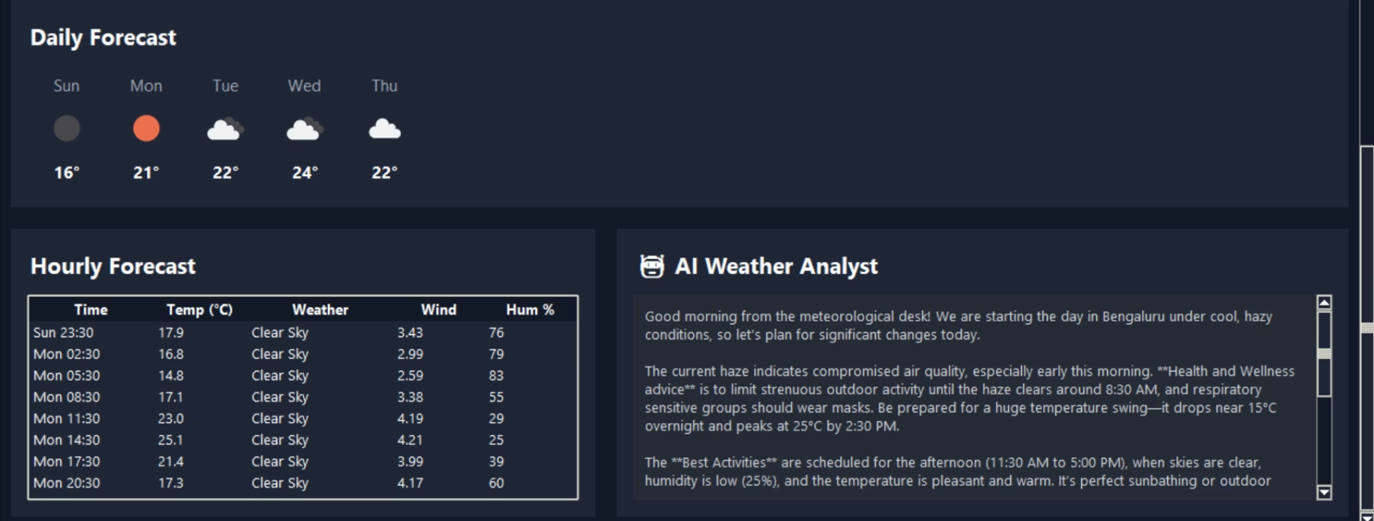
User Interface Showcase
The application features a clean, modern layout displaying current weather conditions, detailed forecast data tables, and an interactive map view. The interface balances information density with visual clarity, ensuring optimal user experience.

Slide 8
Project Summary
Complete Solution
Full-featured real-time weather intelligence platform combining API data, AI reasoning, and interactive visualization for comprehensive weather analysis.
Hybrid Intelligence
Seamlessly blends raw meteorological data with Gemini AI-powered insights to deliver smart, actionable recommendations tailored to user needs.
User-Friendly Design
Intuitive Tkinter interface with smooth navigation, responsive layouts, and instant data access optimized for desktop environments.
Solid Foundation
Strong Python architecture demonstrating best practices in API integration, data processing, and GUI development with clean, maintainable code.
Future Vision: Expandable architecture ready for transformation into a comprehensive weather dashboard with additional features including severe weather alerts, historical data analysis, custom notification systems, and multi-location tracking capabilities.

